Slide 1
Software
Design

Slide 2
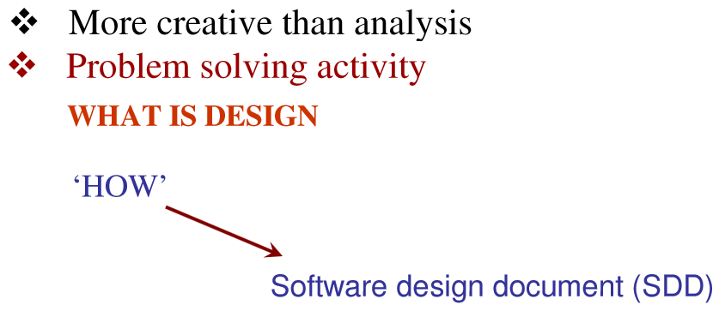
Software Design

Slide 3
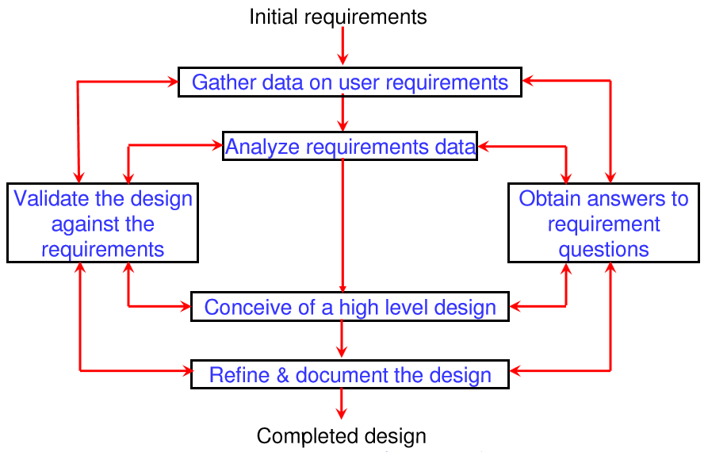
Software Design

Slide 4
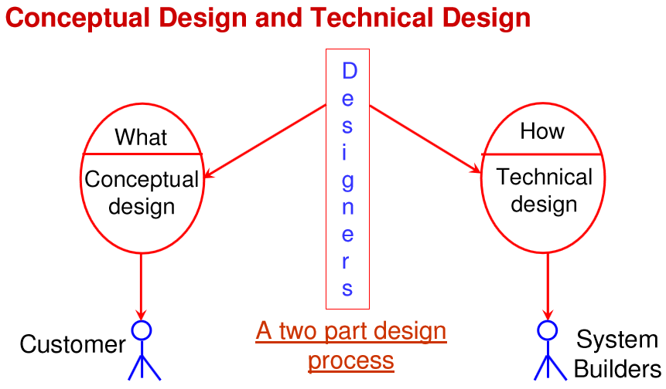
Software Design

Slide 5
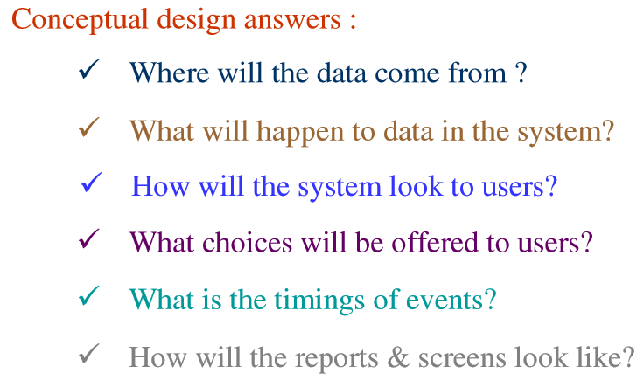
Software Design

Slide 6
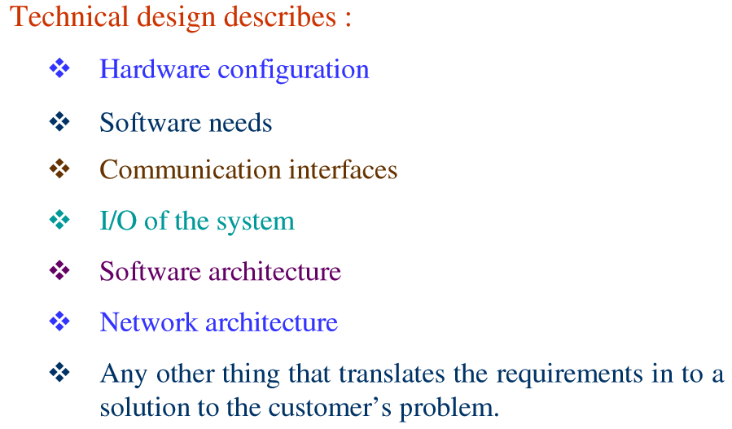
Software Design

Slide 7
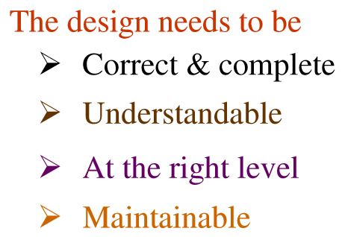
Software Design

Slide 8
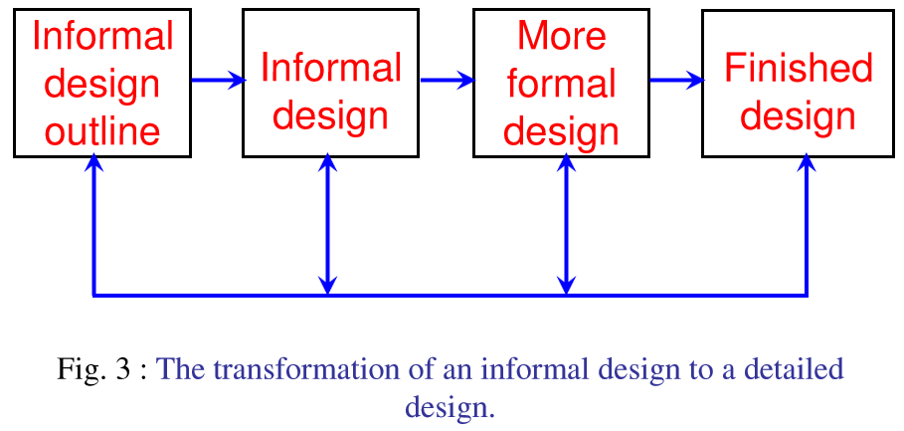
Software Design

Slide 9
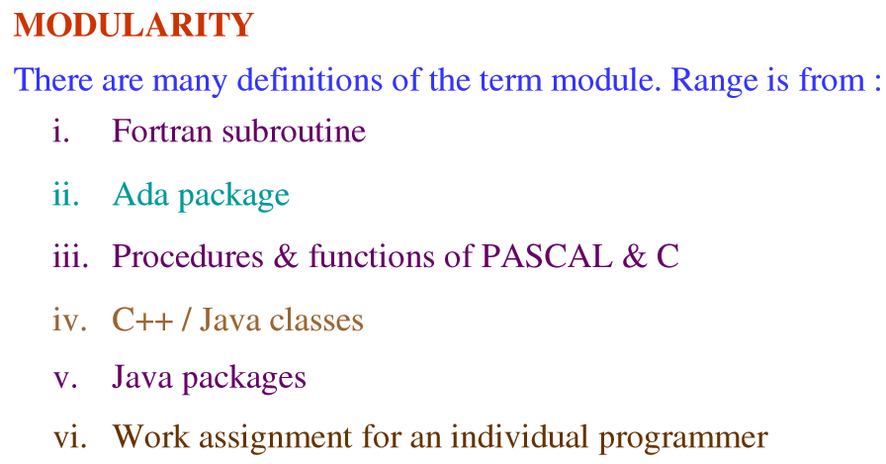
Software Design

Slide 10
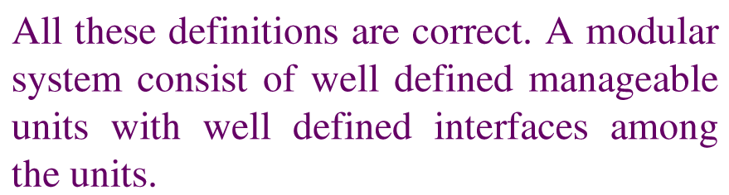
Software Design

Slide 11
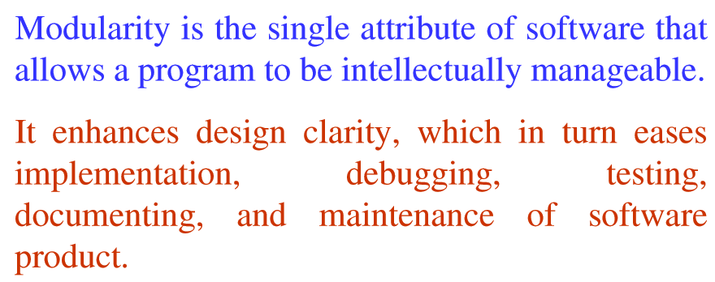
Software Design

Slide 12
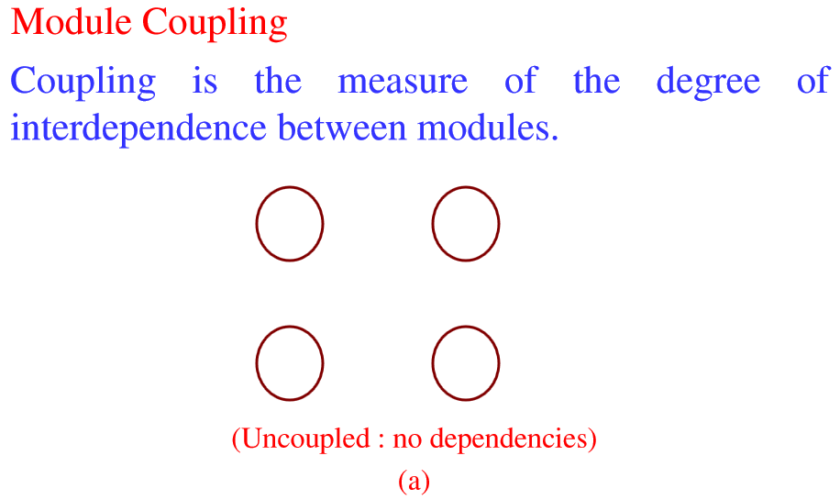
Software Design

Slide 13
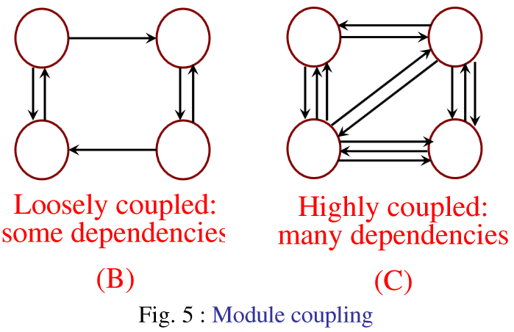
Software Design

Slide 14
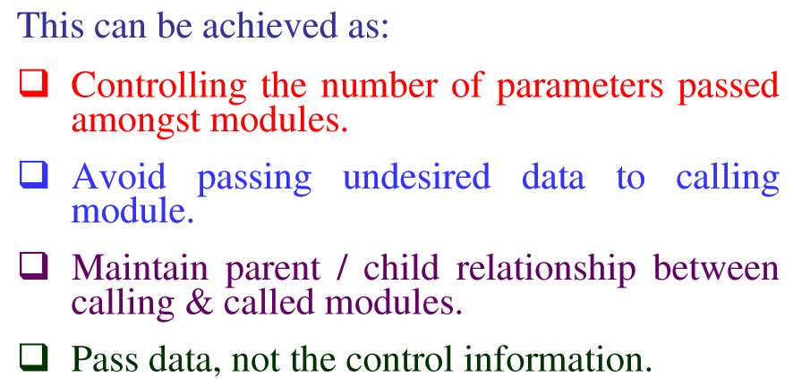
Software Design

Slide 15
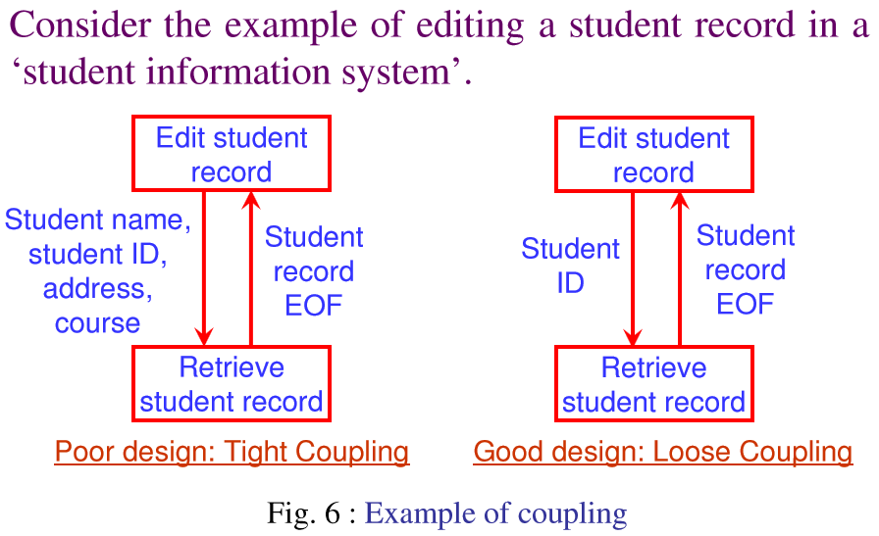
Software Design

Slide 16
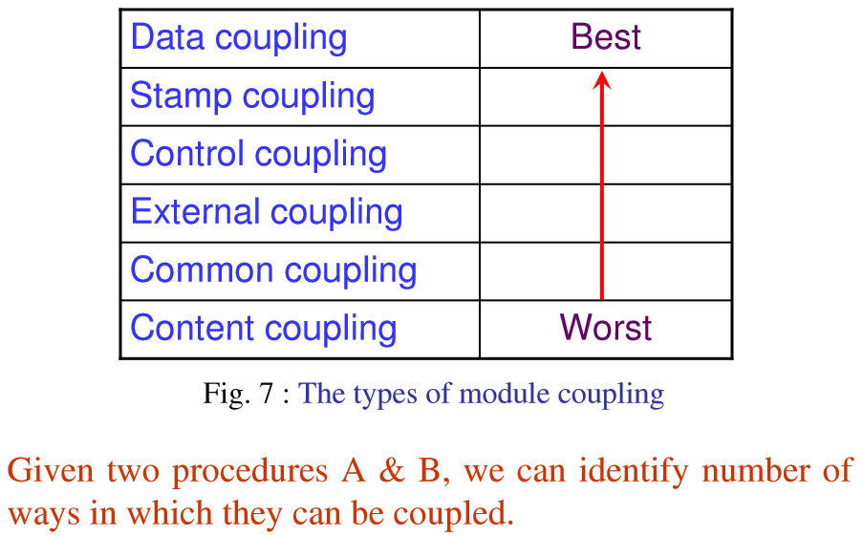
Software Design

Slide 17
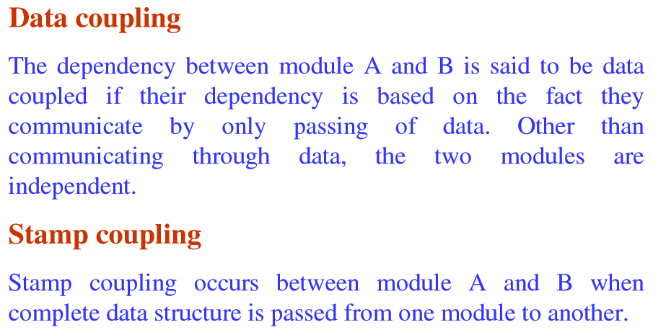
Software Design

Slide 18
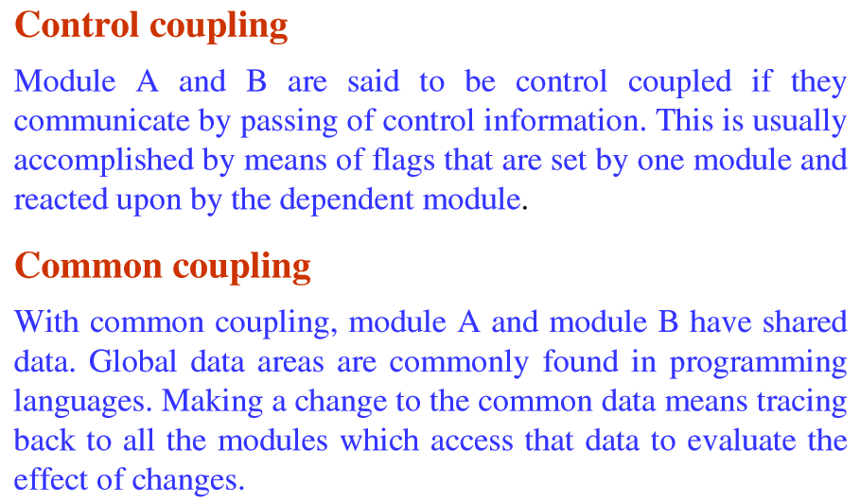
Software Design

Slide 19
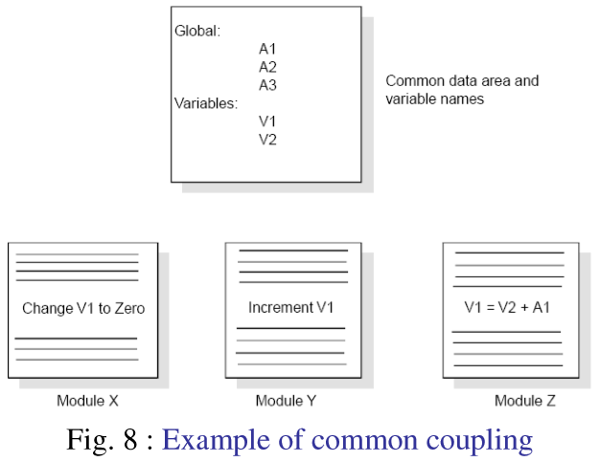
Software Design

Slide 20
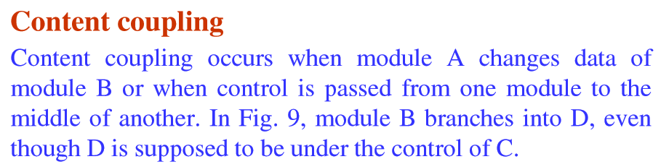
Software Design

Slide 21
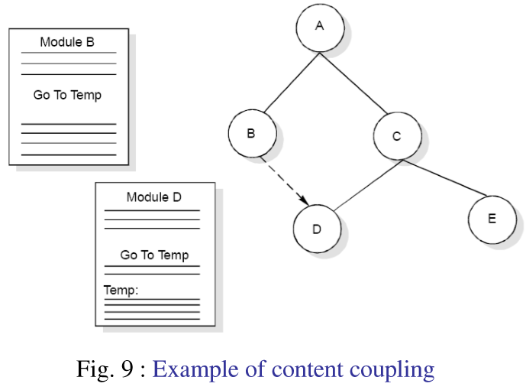
Software Design

Slide 22
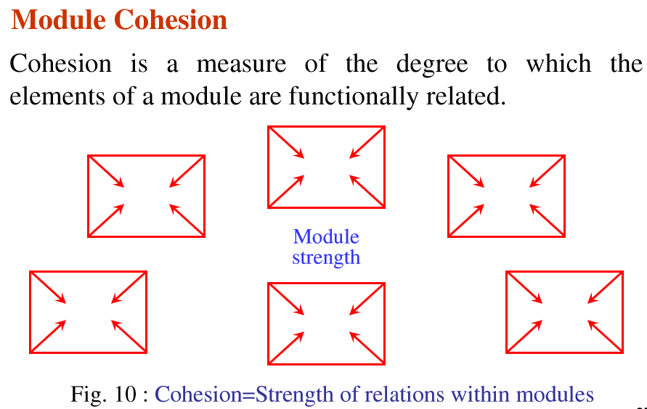
Software Design

Slide 23
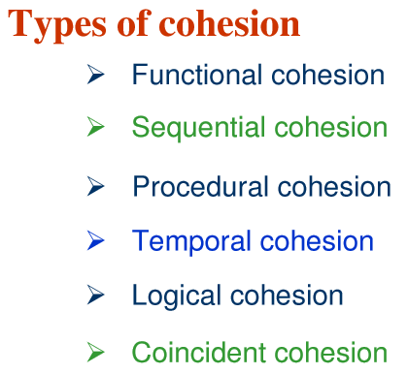
Software Design

Slide 24
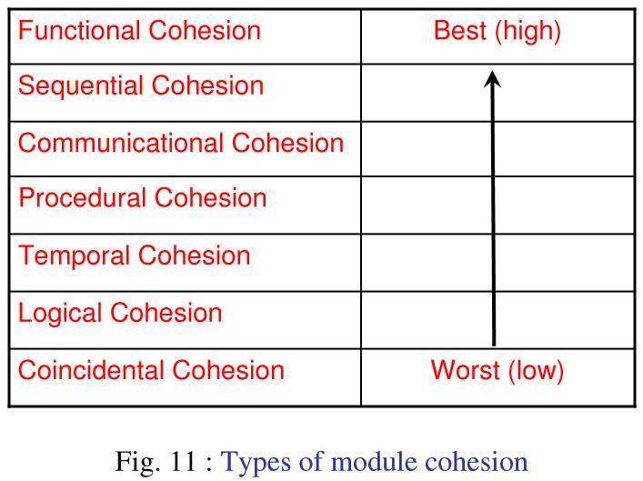
Software Design

Slide 25
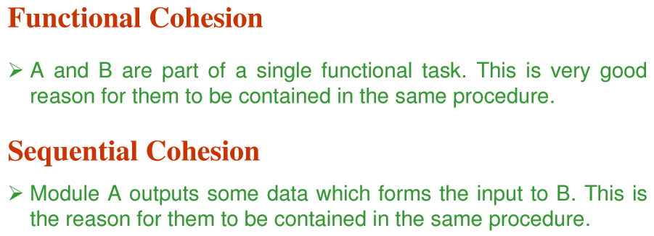
Software Design

Slide 26
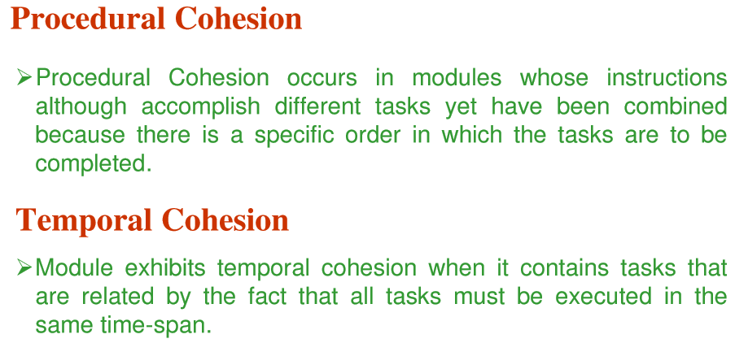
Software Design

Slide 27
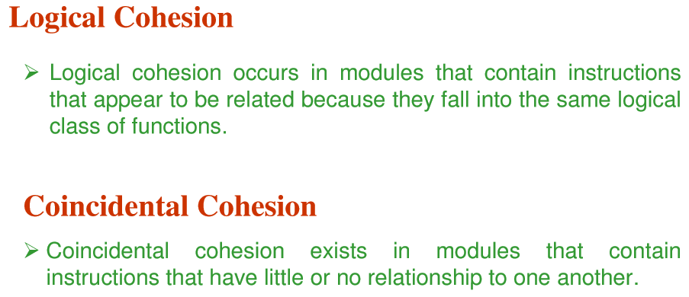
Software Design

Slide 28
Software Design
Functional Cohesion: all elements contribute to a single, well-defined task, i.e. a function that performs exactly one operation get_engine_temperature(), add_sales_tax()
Informational Cohesion: a module performs a number of actions, each with its own entry point, with independent code for each action, all performed on the same data structure. Essentially an implementation of an abstract data type. i.e. define structure of sales_region_table and its operators: init_table(), update_table(), print_table()

Slide 29
Software Design
Sequential Cohesion : operations on same data in significant order; output from one function is input to next (pipeline)
Communicational Cohesion : unrelated operations except need same data or input.
Procedural Cohesion : Elements involved in different but sequential activities, each on different data (usually could be trivially split into multiple modules along linear sequence boundaries).

Slide 30
Software Design
Coincidental Cohesion : (Worst) Module elements are unrelated.
Logical Cohesion : Elements perform similar activities as selected from outside module, i.e. by a flag that selects operation to perform (see also Command Object). i.e. body of function is one huge if-else/switch on operation flag.
Temporal Cohesion : operations related only by general time performed (i.e. initialization() or FatalErrorShutdown?())

Slide 31
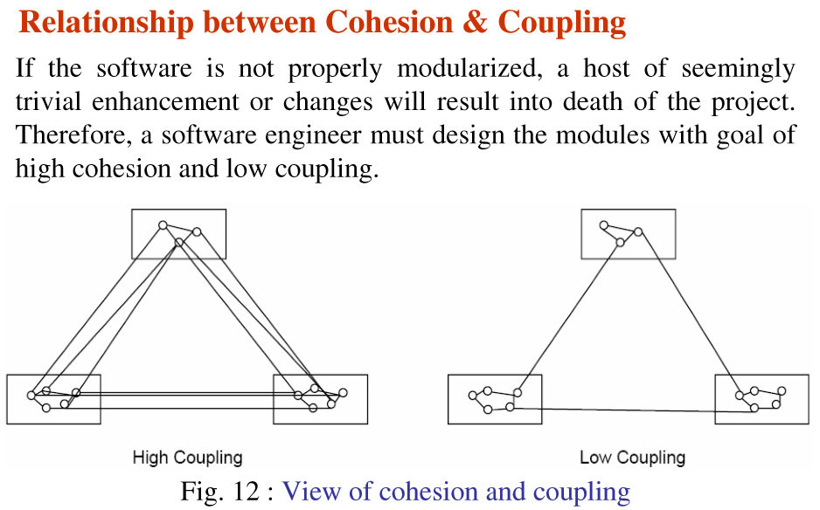
Software Design

Slide 32
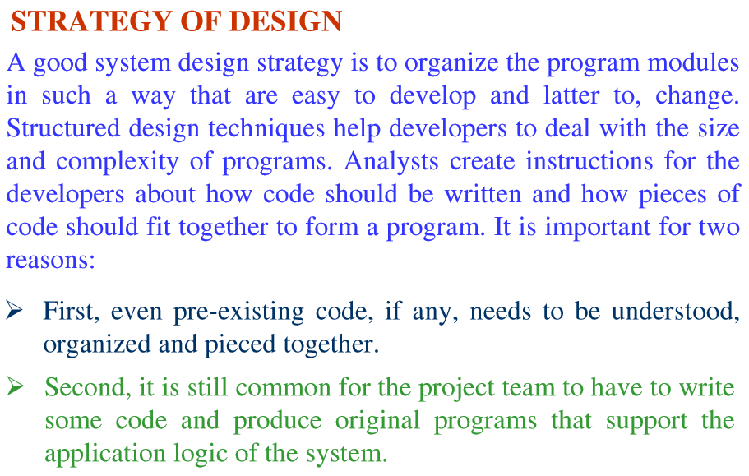
Software Design

Slide 33
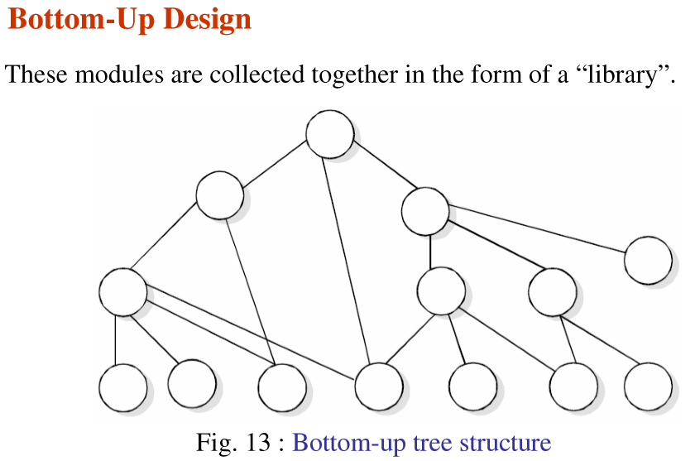
Software Design

Slide 34
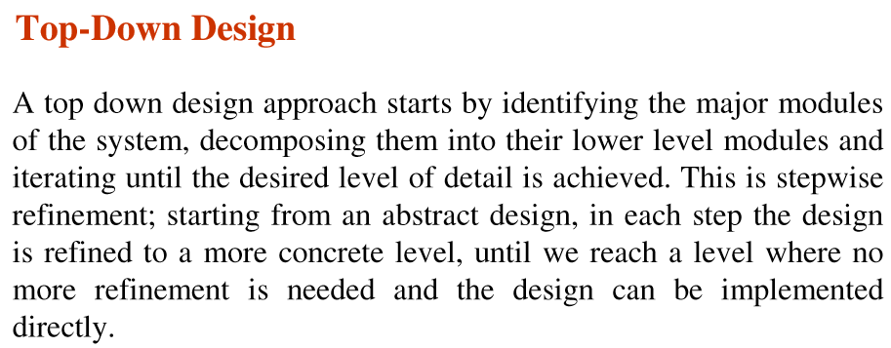
Software Design

Slide 35
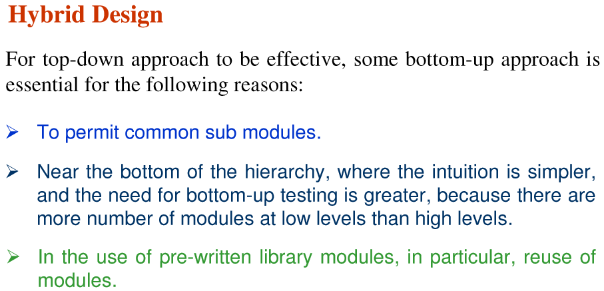
Software Design

Slide 36
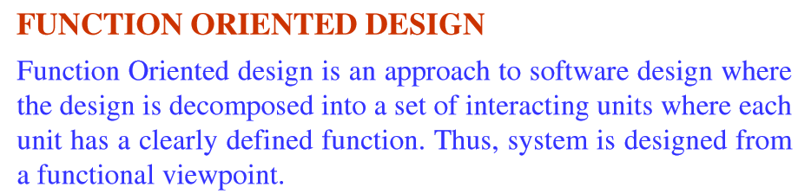
Software Design

Slide 37
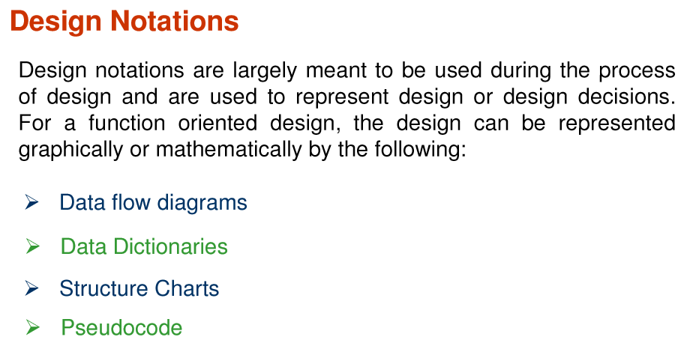
Software Design

Slide 38
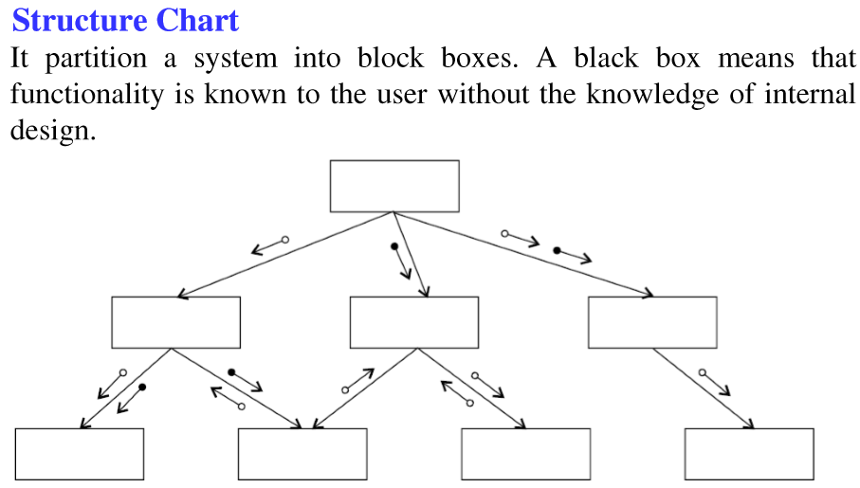
Software Design

Slide 39
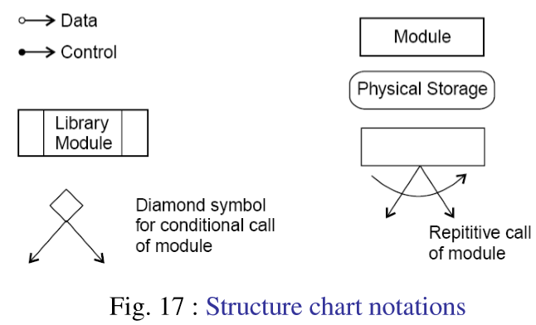
Software Design

Slide 40
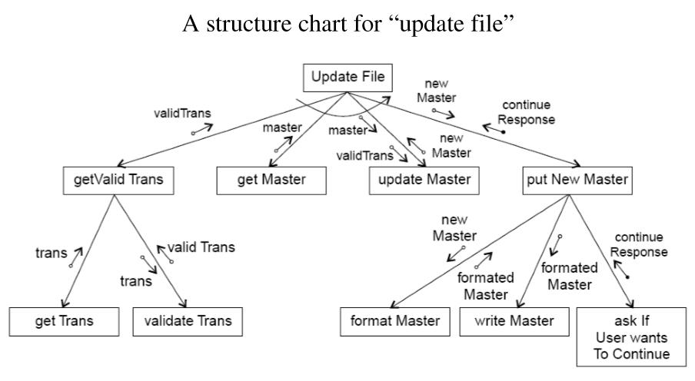
Software Design

Slide 41
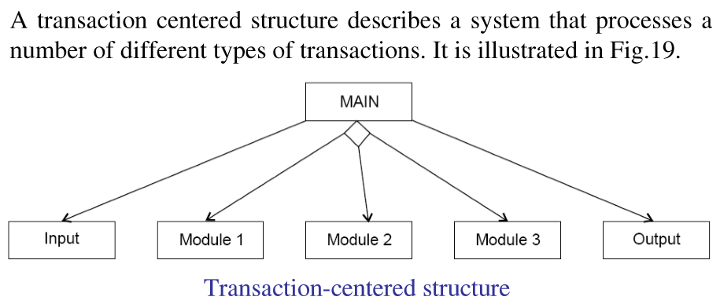
Software Design

Slide 42
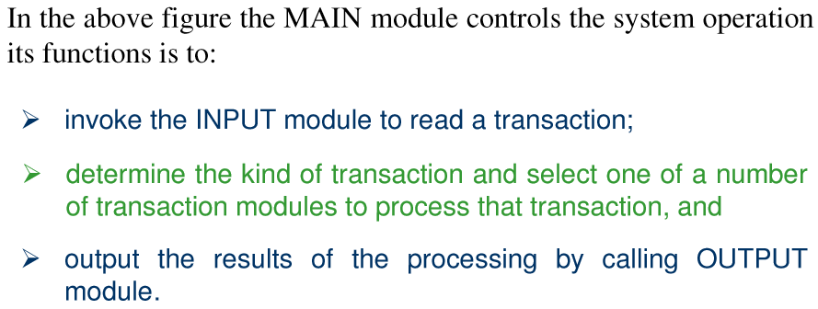
Software Design

Slide 43
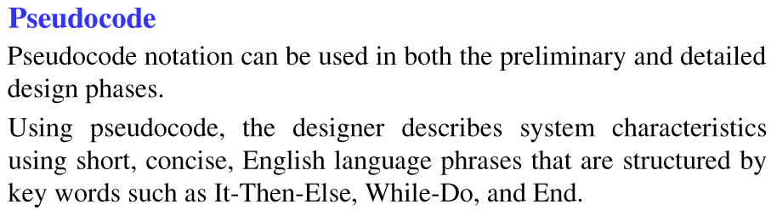
Software Design

Slide 44
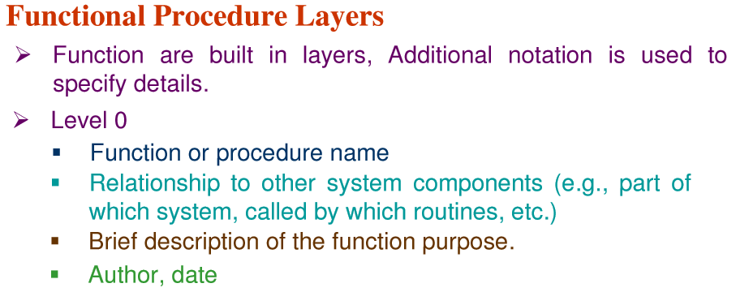
Software Design

Slide 45
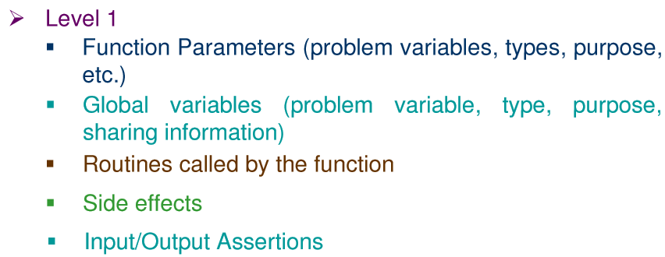
Software Design

Slide 46
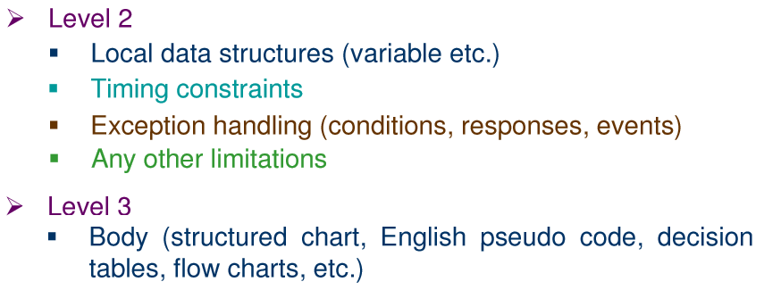
Software Design

Slide 47
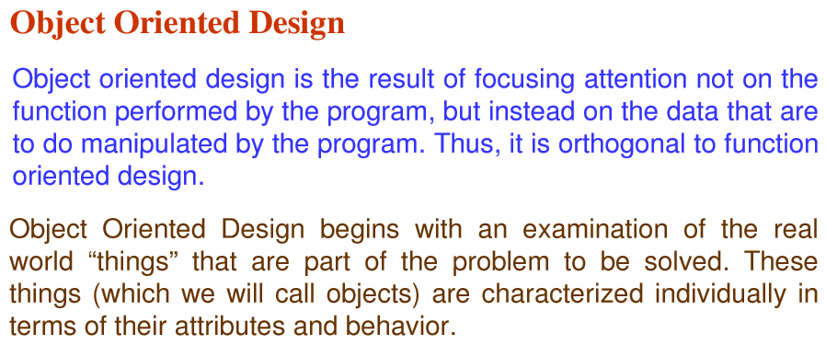
Software Design

Slide 48
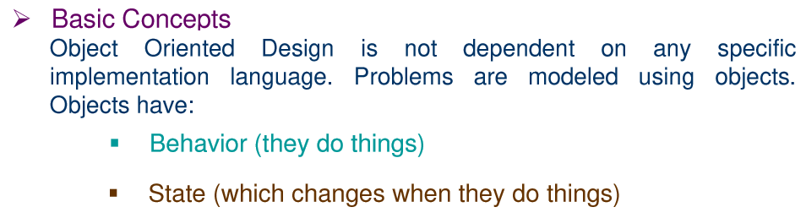
Software Design

Slide 49
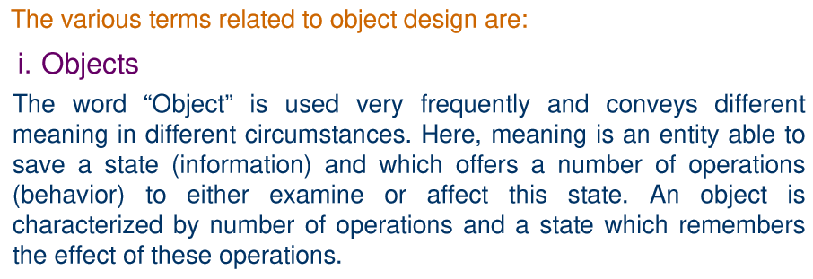
Software Design

Slide 50
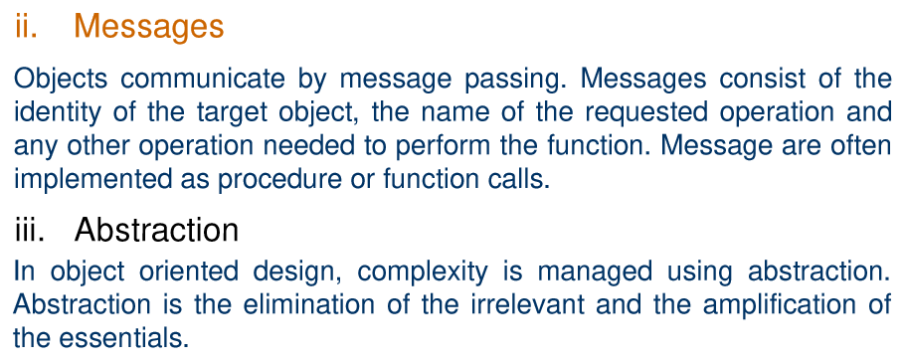
Software Design

Slide 51
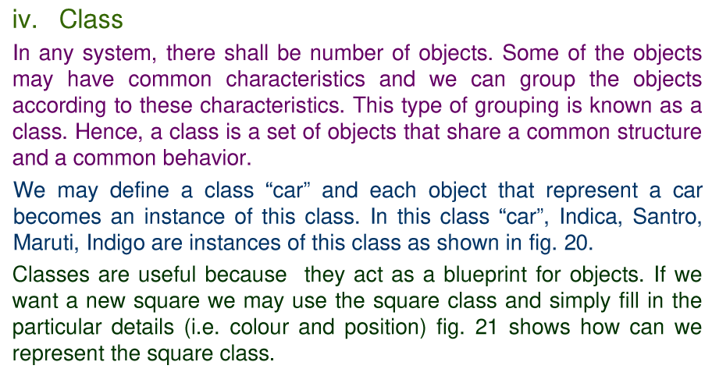
Software Design

Slide 52
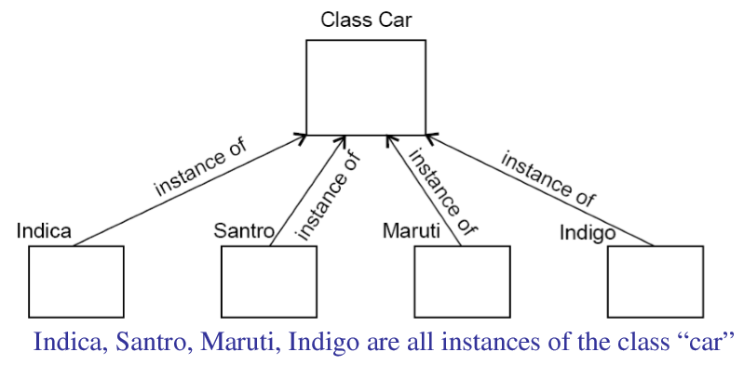
Software Design

Slide 53
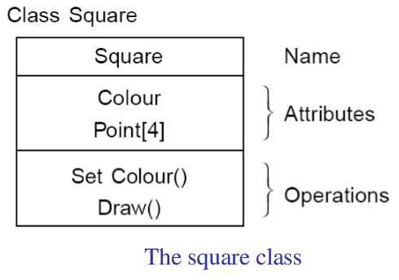
Software Design

Slide 54
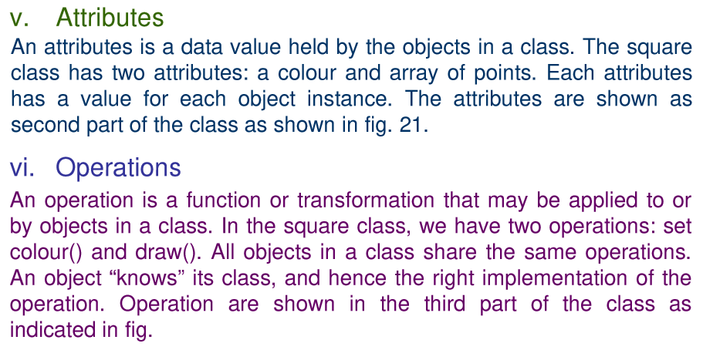
Software Design

Slide 55

Software Design

Slide 56

Software Design

Slide 57

Software Design

Slide 58

Software Design

Slide 59

Software Design

Slide 60


Software Design

Slide 61

Software Design

Slide 62

Software Design

Slide 63

Software Design

Slide 64

Software Design

Slide 65

Software Design

Slide 66

Software Design

Slide 67

Software Design

Slide 68

Software Design

Slide 69

Software Design

Slide 70

Software Design

Slide 71

Software Design

Slide 72

Software Design

Slide 73

Software Design

Slide 74

Software Design

Slide 75

Software Design

Slide 76

Software Design

Slide 77

Software Design

Slide 78

Software Design

Slide 79

Software Design

Slide 80

Software Design

Slide 81

Software Design

Slide 82

Software Design

Slide 83

Software Design

